Slide 1
Project Presentation of CO-OP Project at Industry (Module-2) (22CS421)
On
ComplianceGPT - Security Compliance Copilot RAG Agent
Bhavya Bibra
2210991441 Khyanshu Garg
2210991058
Ayush Pratap Singh
2210991427

Slide 2
Introduction
The Vision: Build an AI-powered platform enabling security professionals to query cybersecurity frameworks, preform automated control mapping, and generate compliance reports with strict citation accuracy.
The Mission: Create an intelligent RAG system combining vector databases, and LLMs to provide semantic framework understanding with hallucination prevention.
Digital Presence: Transform cybersecurity compliance from manual time-intensive workflows into automated, intelligent processes while maintaining enterprise-grade accuracy.
<number>

Slide 3
Problem Statement
Manual Cross-Referencing: Security teams spend 60-70% of time manually researching framework documents and mapping controls across standards.
Knowledge Gaps: Staff turnover creates expertise loss. Organizations struggle with framework updates and continuous compliance monitoring.
Tool Limitations: Traditional GRC tools lack semantic understanding generic AI chatbots produce unreliable hallucinations unsuitable for audits.

Slide 4
Project Scope
Target Audience: Enterprises (compliance teams, security engineers, auditors)
Platform Design Approach: Structured, user-friendly interface inspired by e-commerce workflows.
Validation Loop: Generated AI-generated compliance outputs undergo validation checkpoints .
Reach: Have used metadata for Search Engine Optimization (SEO) and Improves accessibility of compliance knowledge.

Slide 5
Methodology
Full-Stack Integration: React-based frontend with FastAPI backend services.
User-Focused Design: Chat-based UI with evidence panel for transparency and framework select support.
Scalable Data & Auth Layer: Supabase for database, authentication, and RLS policies.
Simplified Communication: Centralized query orchestration via Query Service.

Slide 6
Tools & Techniques
Main Framework:
FastAPI (Backend): High-performance API layer for RAG orchestration
React (Frontend): Interactive chat UI with real-time streaming support
UI Libraries: Modern UI libraries for abstraction and great and well defined and used components.
LLM & Inference:
Groq: Low-latency inference for real-time responses.
OpenRouter (Fallback): Ensures high availability
Jina Embeddings API: High-quality semantic embeddings

Slide 7
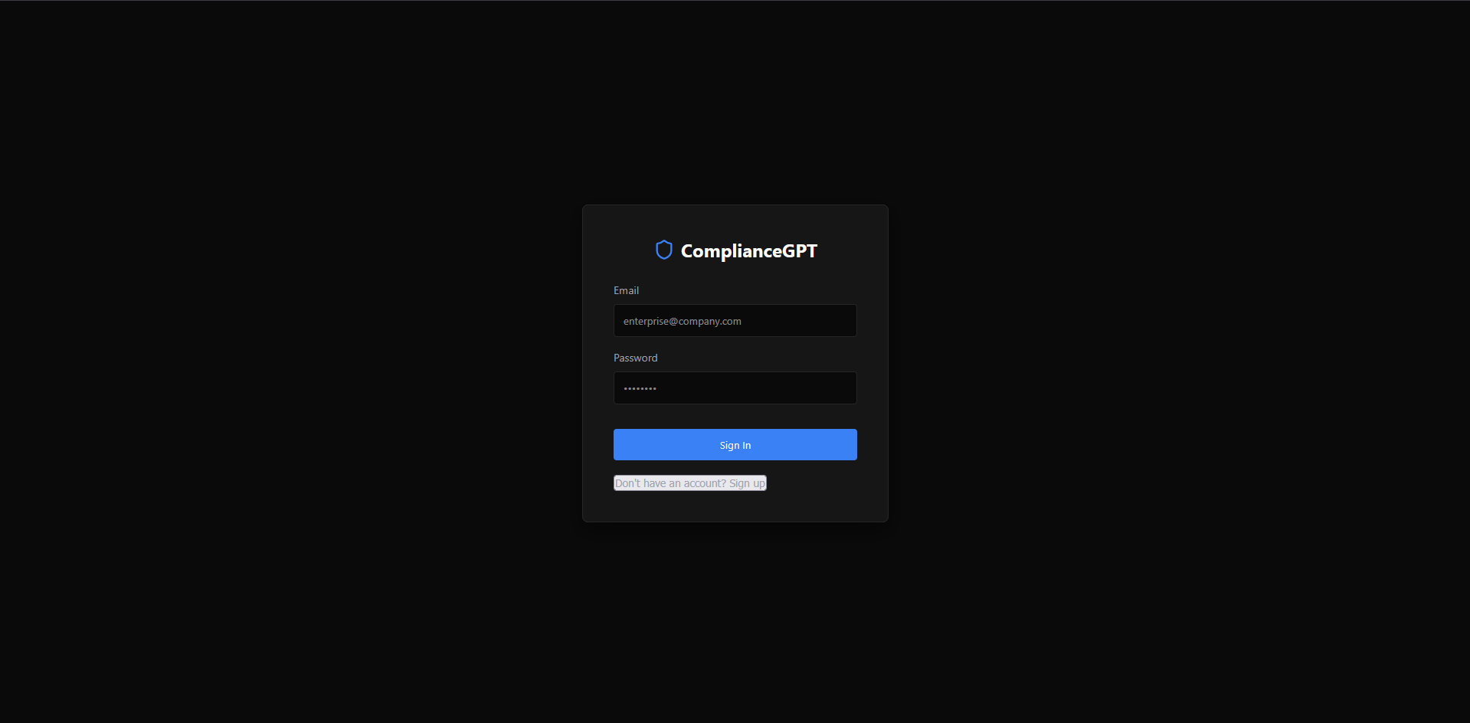
Working Snapshots

Slide 8
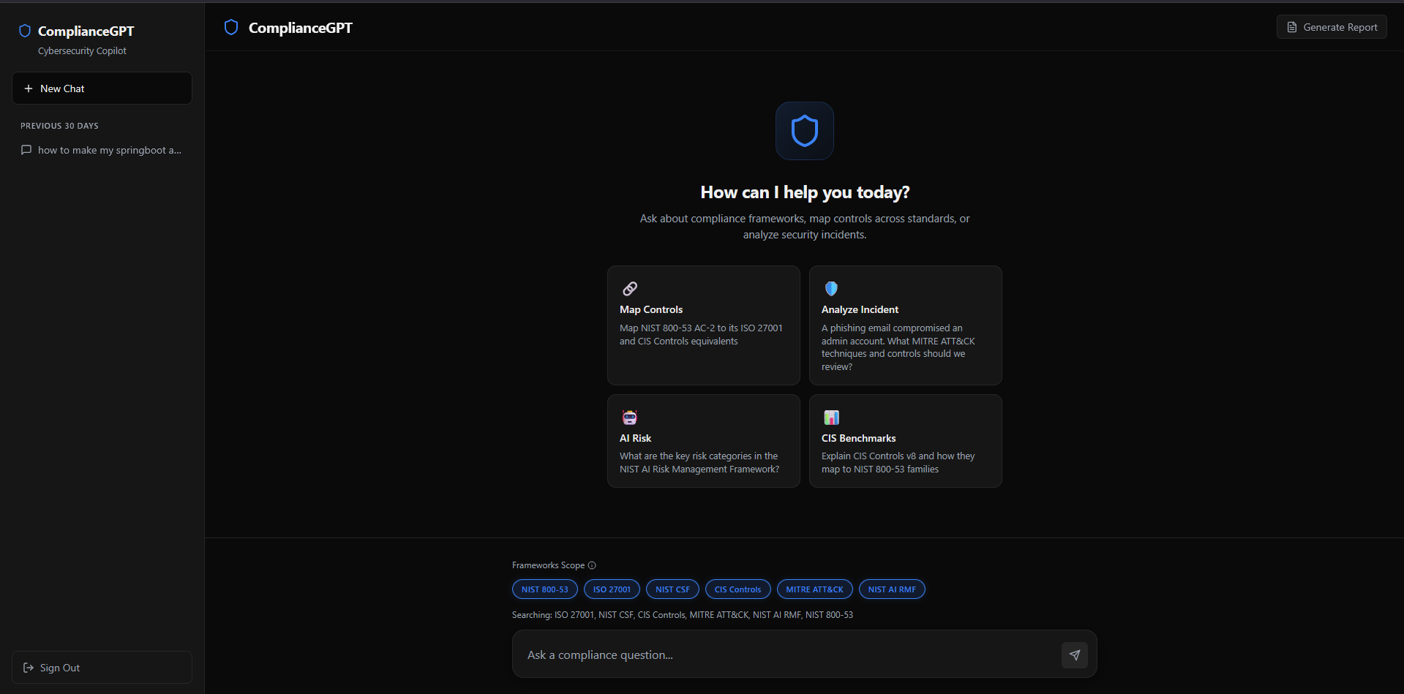

Slide 9
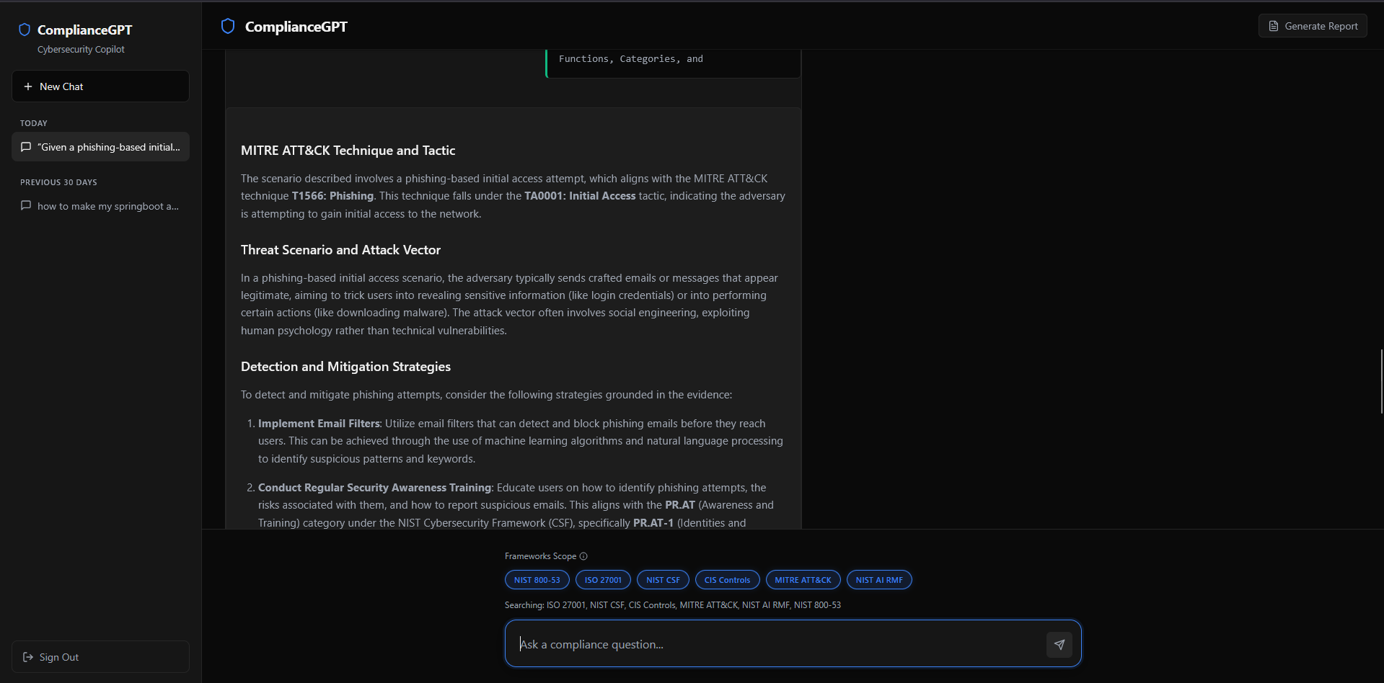

Slide 10
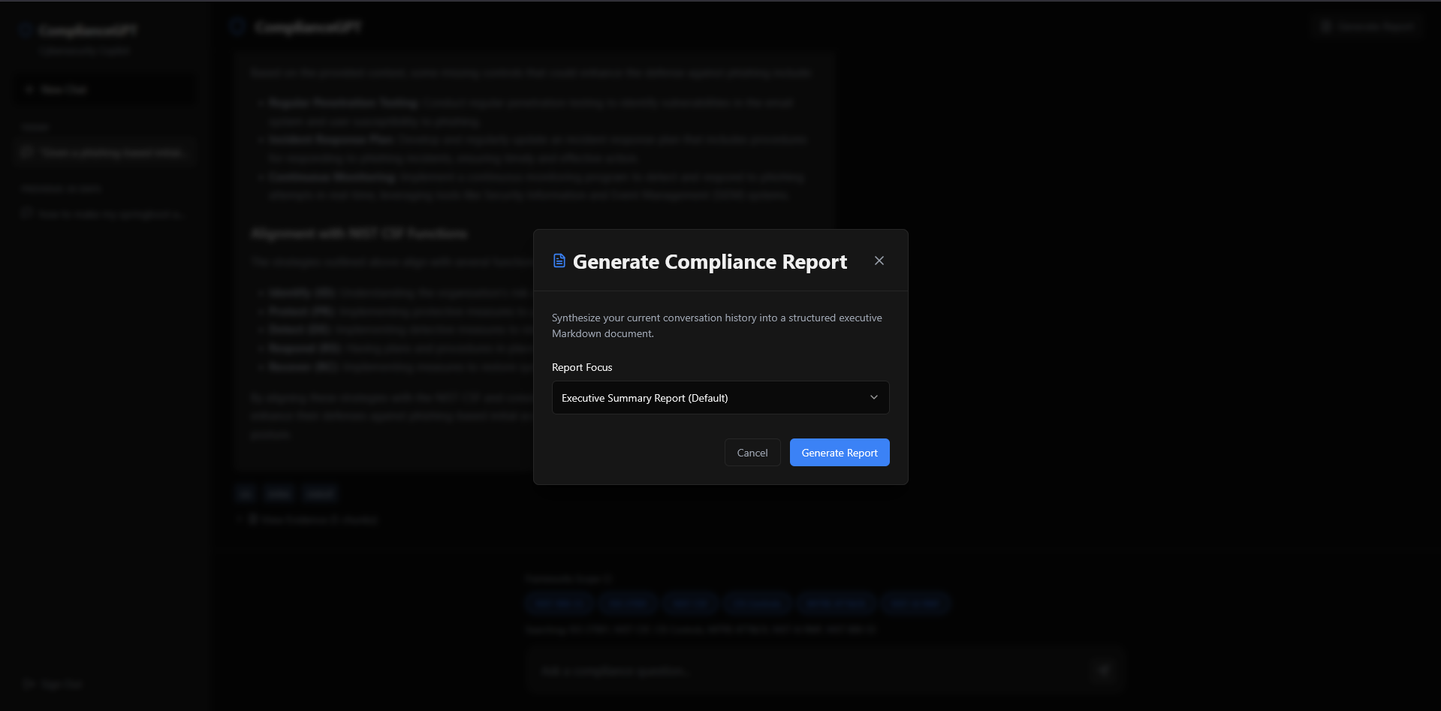

Slide 11
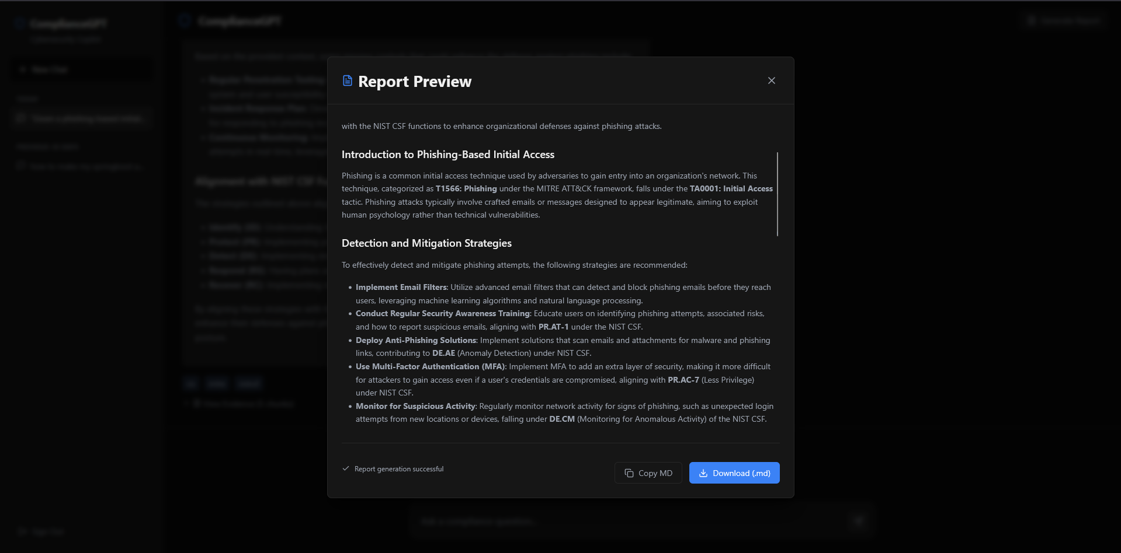

Slide 12
Expected Outcomes & Benefits
Accelerated Compliance Workflows: Reduces time to answer compliance queries and speeds up audit preparation.
Cross-Framework Visibility: Provides unified mapping across multiple security frameworks in one place..
Transparency: Delivers evidence-backed responses with clear citations from source frameworks..
Scalable & Cost-Effective: Minimizes manual effort and reduces dependency on large compliance teams..

Slide 13
Referencs
Below are the list of references used:
https://react.dev/
https://developers.google.com/search/docs/fundamentals/seo-starter-guide
https://fastapi.tiangolo.com
https://www.nist.gov/cyberframework
https://openrouter.ai/

Slide 14
Thank You
<number>

